Slide 1
Forecasting Amazon Stocks Prices
TeamMates
Sri Nikhitha Boddapati - 16322565
Sukumar Bodapati - 16326105
Pavan Kumar Jonnadula - 16324822
Vamsi Alapaty - 18230326

Slide 2
Introduction
In today’s world, there are multiple models to forecast the stock market.
Out of all the techniques, which strategies are the most effective?
Is it better to try to predict stock prices or to trade strategies based on stock price movement?
Can we predict and tell when we can buy a stock using these models?
What parameters can we use for various situations?

Slide 3
Data Set
Y-Finance:
Amazon stocks data is taken from the package y-finance from the day one till today.
Data Exploration:
Closing price of the stock is considered so that the prediction of the next day value can be done.
This dataset is having 6282 number of days.

Slide 4
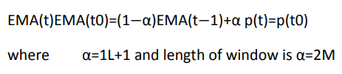
Feature Extraction
To Extract the features from the Data set we are using the below indicators.
Momentum:
Momentum(m)=Latest Price -Closing price (at Number of days ago)
Bollinger Bands:
For Quantitative Analysis of Stock market, this indicator is useful. These are used to characterize the trading range of a financials’ by defining the current high and low values in a market.
EMA(Exponential Moving Average):

Slide 5
Models Used
It consists of two models.
ARIMA
LSTM(Single feature)
LSTM(Multiple feature)

Slide 6
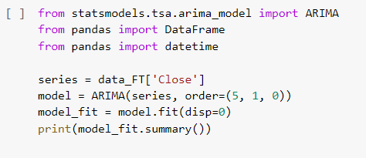
ARIMA Model
Autoregressive Integrated Moving Average(ARIMA) Model is a strategy used for predicting the future values of Time series data.
Model is defined as follows:
‘5’ is set as lag value for regression
‘1’ is used as difference order to make stationary time series
‘0’ is set as moving average model.

Slide 7
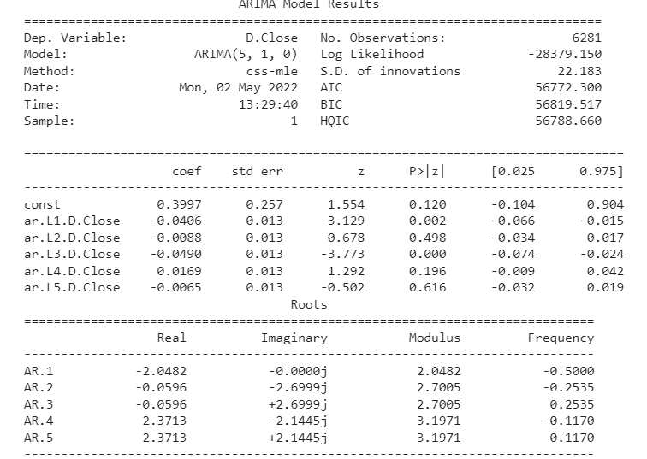
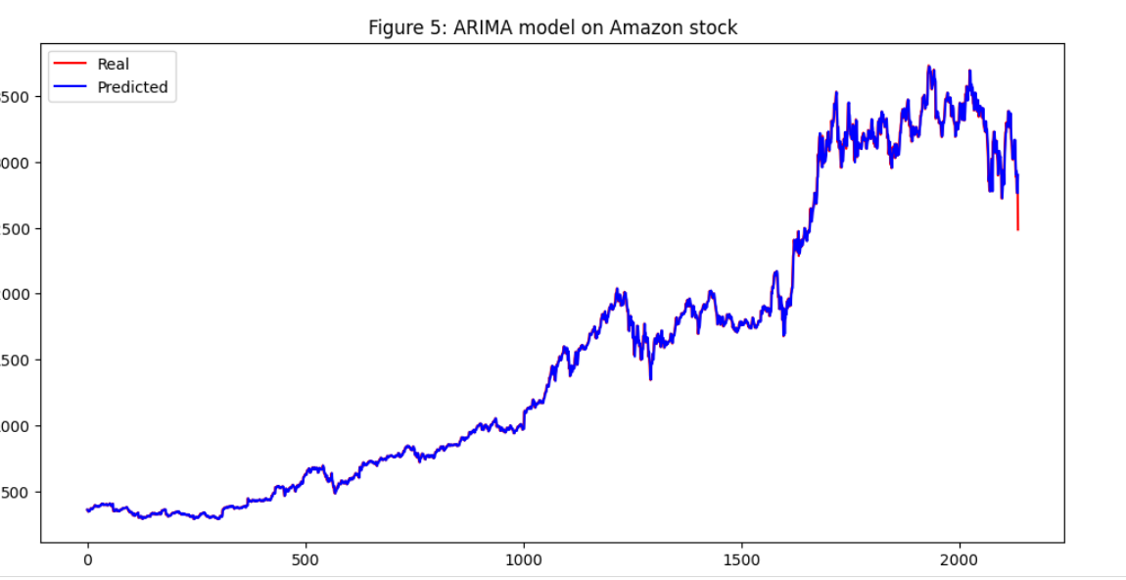
ARIMA Model Results
Visualization of ARIMA Model

Slide 8
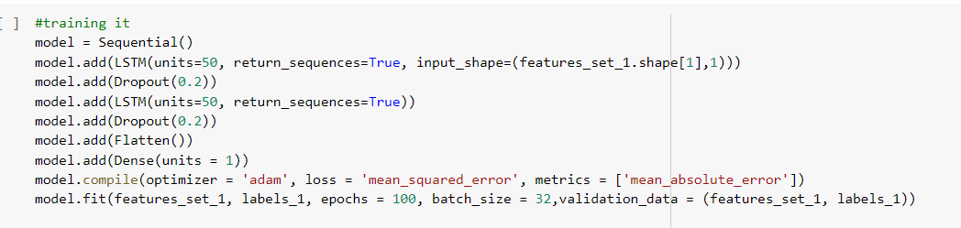
LSTM
The LSTM algorithm excels in forecasting stock market data. We'll first try to forecast closing prices with only one feature, Open (which has the strongest connection to closing prices), and then with many features (using some form of one-hot encoding) to see what we can come up with.
LSTM MODEL(Single Feature) :

Slide 9
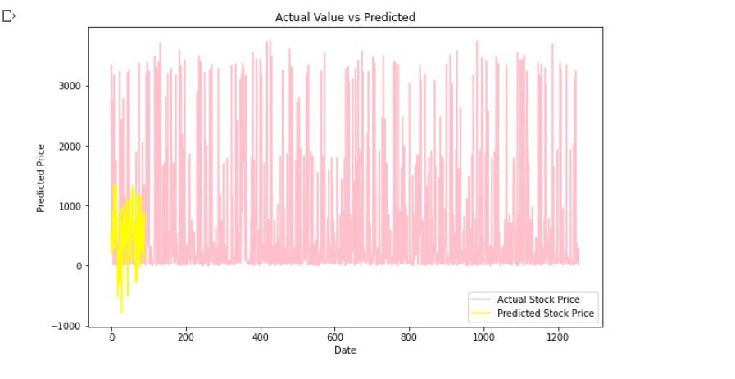
Visualization of LSTM Model
This graph depicts the Actual Stock Price vs Predicted Stock Price.

Slide 10
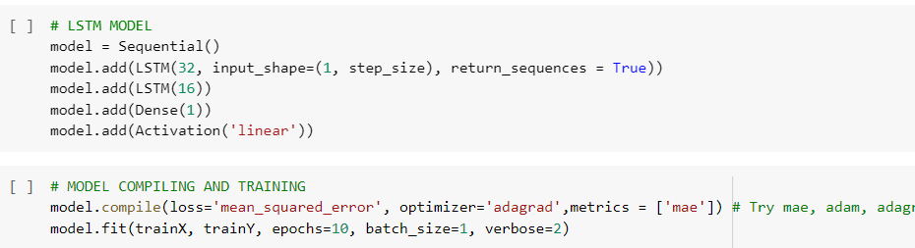
LSTM
Model for Multiple Features

Slide 11
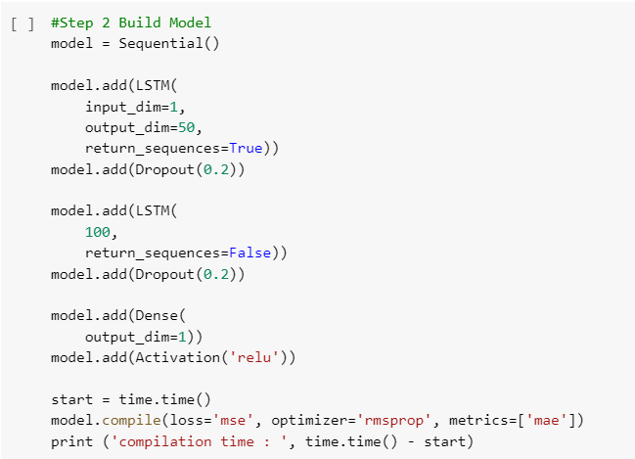
LSTM for Stock Momentum
We merely normalized the closing prices before splitting it into train and test datasets.
Model:

Slide 12
Conclusion
In this project, ARIMA, LSTM, LSTM with multiple features are used to forecast multiple models of the time series OHLCV data, perform feature extraction, hyper parameter tweaking, and train on ARIMA, LSTM.
Based on the above conclusions, LSTM works well.
Future Work:
Stock prediction can be done using GAN. We tried to implement using TimeGAN but due to complex architecture and time constraints, we couldn’t complete it.
We can predict the next day values for different datasets from Day 1 to till today.
This model can be integrated into any web application where we can show the predict of next day stock value for all the trending stocks(Creating the stock market website).

Slide 13
Thankyou…

